Slide 1

第四章 光的传播和叠加
刘智波
南开大学物理科学学院
2022年

Slide 2
波动光学的建立
1678年，Huygens提出光的波动学说。
1801年，T．Young在光通过双孔的实验中，首次观察到了光的干涉现象。
1808年，Malus观察到了光的偏振现象，说明光是横波。
1865年，Maxwell提出电磁波理论，断言光是电磁波。
1887年，Hertz证实光是电磁波。
光的电磁波模型

Slide 3
光子能量
波长
频率
γ射线
x射线
紫外光
可见光
红外光
无线电波
短波
电视、调频波
标准广播
长波

Slide 4
光波长的范围
紫外光 可见光 红外光
50nm------400nm-------760nm--------100μm
对红外光1μm------------10μm-----------100μm
近红外 中红外 远红外
对紫外光(UV)，其波长较短的部分由于只能在真空中传播，被称为真空紫外光（VUV）

Slide 5
光波场
光是交变电磁波
波长~500nm，频率~10¹⁴Hz
从传播的角度看，是波动，是振动的传播
用速度、方向、振幅等参数描述
从物理量分布的角度看，是空间场
用电场强度、磁场强度等物理量描述
时间、空间是描述波的重要参量

Slide 6
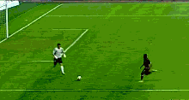
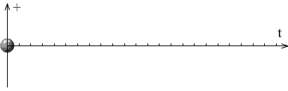
Wave
In the classical term, “wave concept” is distinct from “particle concept”
A feature of “classical particle” is its localisation
— an object is confined to very small region
A feature of “classical wave” is its non-localisation:
— self-sustaining, propagating disturbance of a medium over a long distance
classical particle
Classical : > 10 μm
classical wave

Slide 7
Waves: Non-Localisation
1st feature = “medium”
— Spring, string, water, air, human, etc.
— Solid, liquid, and gas
— The medium does not advance, after the disturbance it returns to its original balanced position
2nd feature = “disturbance”
— The disturbance advances, travels, propagates, moves outwards, or move forwards,
— The disturbance transports or carries energy and momentum
— The disturbance is a continuous entity

Slide 8
Waves
Disturbance = ψ
It is a function of the position and the time
y = f (x, t)
At a fixed time, it has a shape (or profile)
— Spatial profile at t = t₀ :
y (x,t) = f (x, t₀) = g(x)
— Temporal profile at x = x₀:
y (x,t) = f (x₀, t) = h(t)
It may be
— Medium displacement (unit : meter)
— Temperature (unit : Kelvin)
— Pressure (unit : Newton / meter²)
Classified according to medium
— Water wave, sound waves mechanical
— Heat waves thermal
— Mexican waves human
It can be described mathematically by a wave-function of a unit of (x + υ t)
ψ = f ( x’) = f ( x + υ t)
two independent variables: x and t
υ = velocity (or speed) = a constant
The sign indicates travelling direction
— if travelling to +x direction, it’s (x – υ t)
— if travelling to -x direction, it’s (x + υ t)

Slide 9
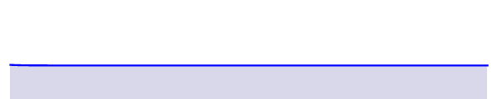
Types of Waves
A periodic wave: sinusoidal wave
Classified according to displacement direction
— Longitudinal = parallel to travelling direction
— Transverse = perpendicular to travelling direction
Classified according to periodic or non-periodic
Classified according to travelling or standing
Classified according to 1, 2, or 3 dimensioning
A non-periodic wave: soliton wave

Slide 10
Wave Equation
What is the simplest case for wave?
One-dimensional in space
— Do not take y as another dimension, y describes the disturbance at a position, x
— Linear (do not have the term y ^{n} , n >1; and the order of the derivative does not account)
— Homogeneous (uniform, u is not a function of x)
— Neither “loss (damped)” nor “source” is presented in the medium
Wave function
Here, for sure, v may change with time and location. As the zeroth approximation, we take v as a constant). x and t are two independent variables. So we have:

Slide 11
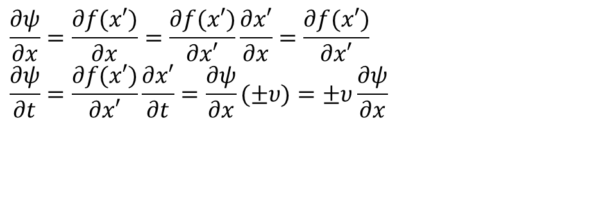
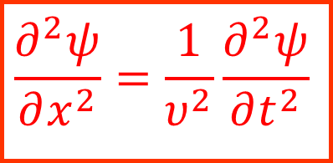
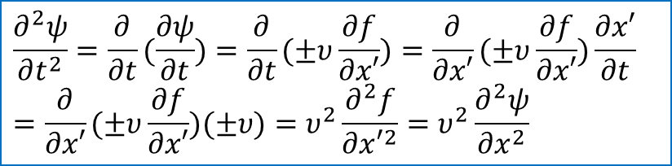
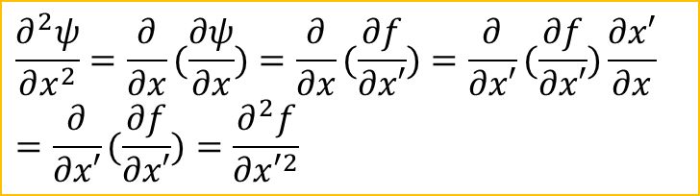
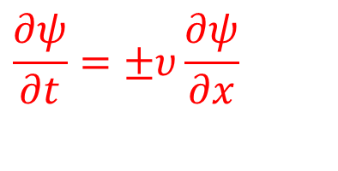
Wave Equation
The second order differential:
Calculate the partial differential, we have:
$$\frac{∂^{2}ψ}{∂x^{2}}=\frac{∂}{∂x}(\frac{∂ψ}{∂x})=\frac{∂}{∂x}(\frac{∂f}{∂x′})=\frac{∂}{∂x′}(\frac{∂f}{∂x′})\frac{∂x′}{∂x} \\ =\frac{∂}{∂x′}(\frac{∂f}{∂x′})=\frac{∂^{2}f}{∂x′^{2}}$$
$$\frac{∂ψ}{∂x}=\frac{∂f(x′)}{∂x}=\frac{∂f(x′)}{∂x′}\frac{∂x′}{∂x}=\frac{∂f(x′)}{∂x′} \\ \frac{∂ψ}{∂t}=\frac{∂f(x′)}{∂x′}\frac{∂x′}{∂t}=\frac{∂ψ}{∂x}(±υ)=±υ\frac{∂ψ}{∂x}$$
$$\frac{∂^{2}ψ}{∂t^{2}}=\frac{∂}{∂t}(\frac{∂ψ}{∂t})=\frac{∂}{∂t}(±υ\frac{∂f}{∂x′})=\frac{∂}{∂x′}(±υ\frac{∂f}{∂x′})\frac{∂x′}{∂t} \\ =\frac{∂}{∂x′}(±υ\frac{∂f}{∂x′})(±υ)=υ^{2}\frac{∂^{2}f}{∂x′^{2}}=υ^{2}\frac{∂^{2}ψ}{∂x^{2}}$$
The first order differential equation comes to be:
$$\frac{∂ψ}{∂t}=±υ\frac{∂ψ}{∂x}$$
$$\frac{∂^{2}ψ}{∂x^{2}}=\frac{1}{υ^{2}}\frac{∂^{2}ψ}{∂t^{2}}$$

Slide 12
Common 2nd order derivative in physics
Newton’s Mechanics:
Quantum Mechanics:
Wave Motions:

Slide 13
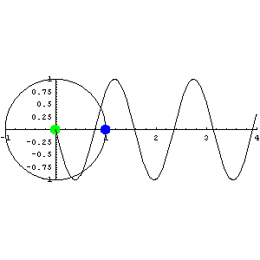
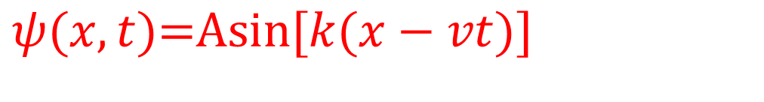
Harmonic Waves
One solution of the differential wave equation is the sinusoidal wave or harmonic wave or sine function
A = amplitude
k (x - vt) = ϕ = phase
k = propagation number
It is periodic, transverse, and travelling
$$ψ(x,t)\text{=}\text{Asin}[k(x−vt)]$$
P
ωt
θ₀
O A

Slide 14
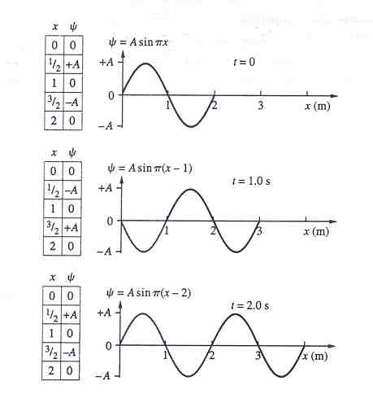
光的电磁理论
Harmonic Waves
At a fixed time, spatial profile gives
— spatial period: wavelength = λ
— spatial frequency: wave number = 1/ λ= κ
— propagation number: k = 2π / λ = 2π κ
At a fixed position, temporal profiles gives
— temporal period : τ
— temporal frequency: ν = 1/τ
— angular temporal frequency: ω = 2πν = 2π/ τ
— Relation υ = ν λ

Slide 15
光的电磁理论
Phase and Phase Velocity
Phase presents vibration of the disturbance:
−−
−−
−− ϕ₀, Initial phase
Initial phase ϕ₀ determines the disturbance at x = 0 and t = 0.
−−
Initial phase ϕ₀ changes with your selection of spatial and temporal reference system.

Slide 16
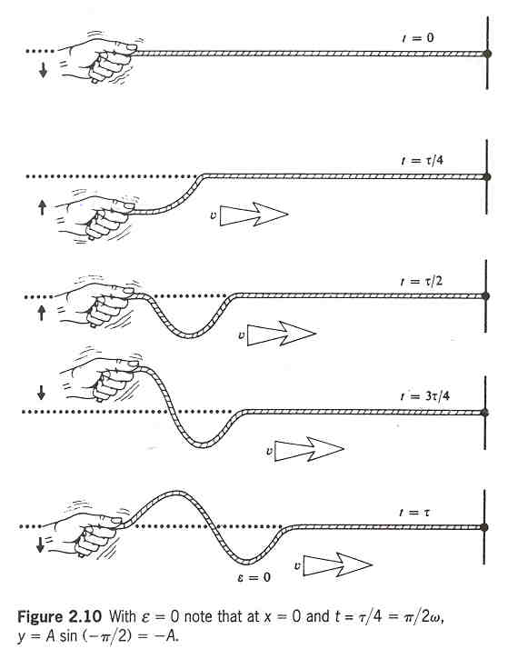
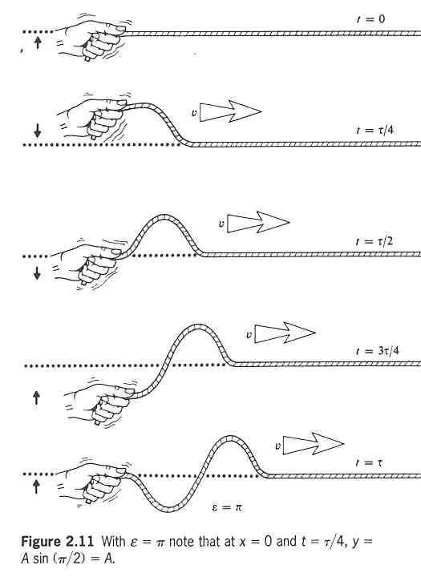

Slide 17

Phase and Phase Velocity
Rate-of-change of phase with time
Rate-of-change of phase with distance
Phase velocity: rate-of-change of distance with time

Slide 18
The Complex Representation
In complex representation, cosine (or sine) function is related to the real (or imaginary) part of a complex number
By Euler formula, a harmonic wave is expressed by a complex exponential function and its complex conjugate
With complex representation, one may find easier treatment for addition, subtraction, multiplication, or division of several harmonic waves

Slide 19
The Complex Representation
The Euler formula
We have
Or in other forms

Slide 20
The Complex Representation
It is straightforward that the complex and the real representations have the same result in the operations of addition and subtraction.

Slide 21
The Complex Representation
Given a quantity z
Its complex conjugation is
Its modulus satisfies the following relation

Slide 22
The Complex Representation
So a harmonic wave can be written in several forms:

Slide 23
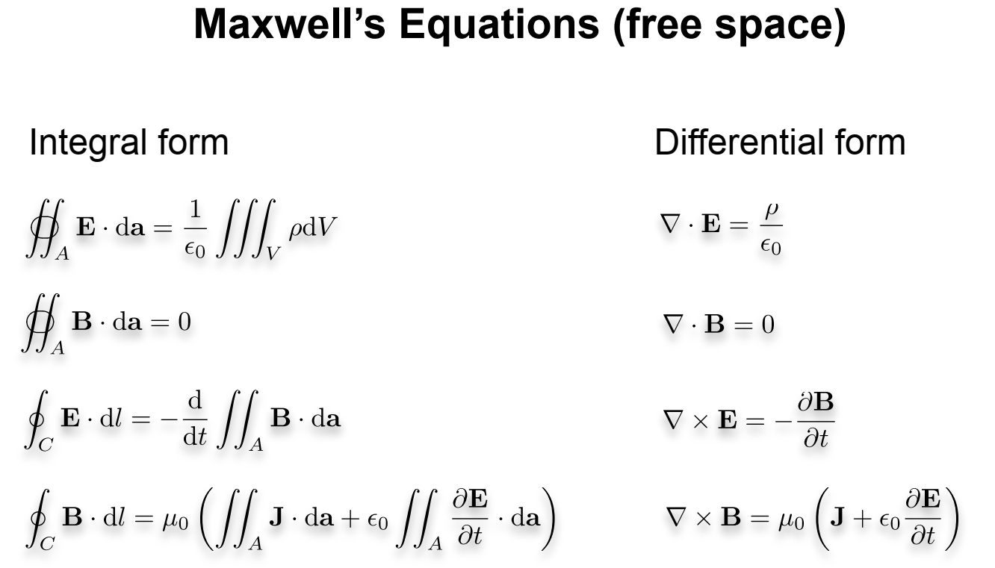

Slide 24
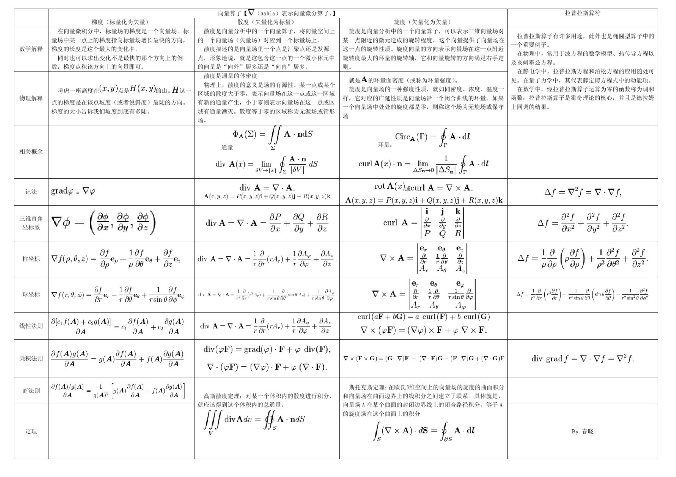

Slide 25
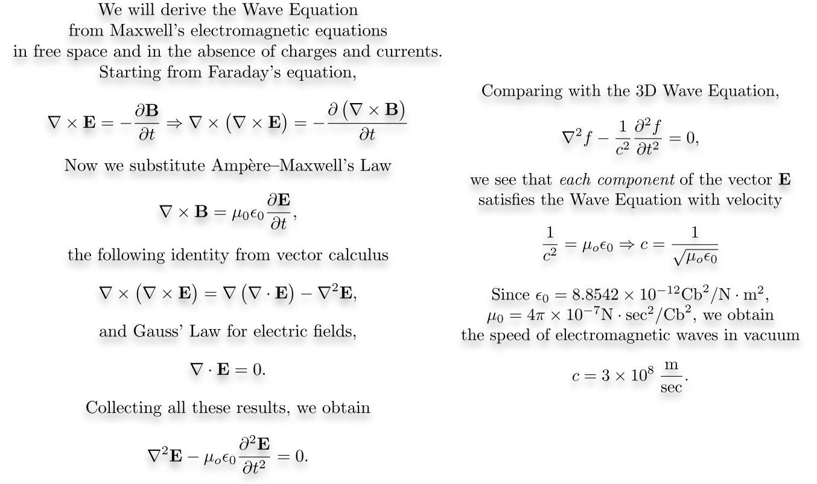

Slide 26
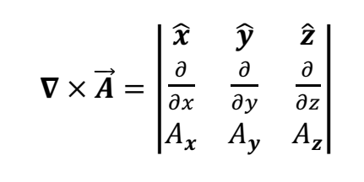
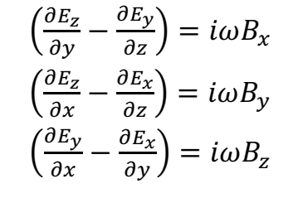
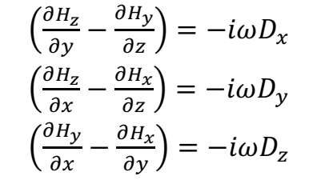
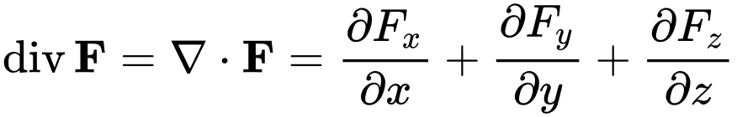
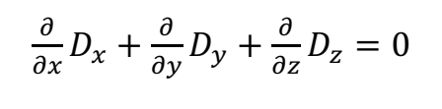
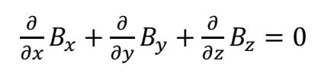

Slide 27
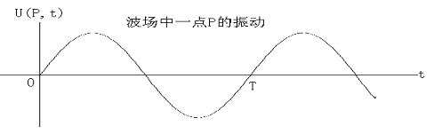
波的周期性
时间周期性：波场中任一点的物理量，随时间做周期变化，具有时间上的周期性
T：时间周期；ν＝1/T：时间频率，单位时间内变化（振动）的次数

Slide 28
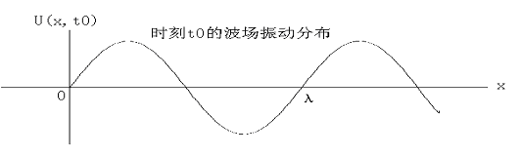
空间周期性：某一时刻，波场物理量的分布，随空间作周期性变化，具有空间上的周期性
波长λ：空间周期； ：空间频率，单位距离内的变化次数，波数
波场具有空间、时间两重周期性

Slide 29
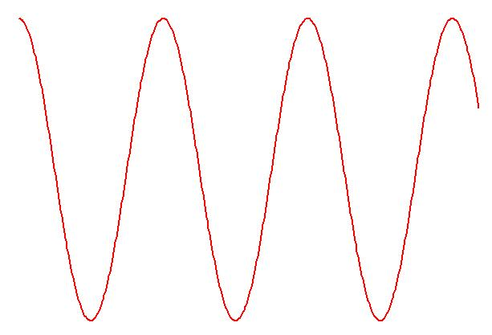
简谐波的数学描述
最简单的是简谐波，其振动可以用三角函数表示，在一维情况下，为
表示沿X方向传播的余弦波

Slide 30
2π时间内的频率，圆频率（角频率）
2π长度内的波数，角波数（圆波数），波矢
波的相位，与时间和空间相关
振动取决于相位，所以振动的传播就是相位的传播。

Slide 31
光波是电磁波（矢量波）
电场分量、磁场分量、波的传播方向即波矢等物理量，都是矢量。
波矢
传播方向的单位矢量
电场分量的振幅、磁场分量的振幅、波长、频率等物理量是标量

Slide 33
光速
真空中的光速
折射率
对于透光的介质
故

Slide 34
光通量与光强
光波传播能量
光通量：单位时间内，通过某一截面的能量，或通过某一截面的光功率；也称能流
光强：单位面积上光通量的平均值，就是平均能流密度

Slide 35
能流密度，就是坡印廷矢量
坡印廷矢量表示的是能流密度的瞬时值，这一数值以光的频率作周期性变化，光强是指能流密度的平均值。
如光波做简谐振动，E₀为简谐振动的振幅，则光强
即
在同一种均匀介质中，通常取

Slide 36
光的传播
光的传播，是振动的传播，就是将光波场中物理量（电场强度、磁场强度）从空间的一点传播到另一点

Slide 37
波场的量值由相位决定
物理量的传播其实就是相位的传播，在传播的过程中，相位保持不变。

Slide 38
1.2 定态光波
1．定态光波
具有下述性质的波场为定态波场
（1）空间各点的扰动是同频率的简谐振动。
（2）波场中各点扰动的振幅不随时间变化，在空间形成一个稳定的振幅分布。

Slide 39
满足上述要求的光波应当充满全空间，是无限长的单色波列。但当波列的持续时间比其扰动周期长得多时，可将其当作无限长波列处理。
任何复杂的非单色波都可以分解为一系列单色波的叠加。
定态光波不一定是简谐波，其空间各点的振幅可以不同。

Slide 40
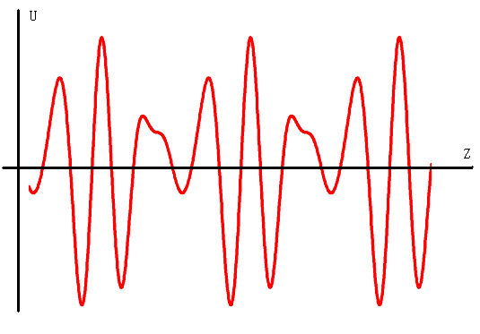

Slide 41
2．定态光波的描述
电磁波都是矢量波，应该用矢量表达式描述。但对符合上述条件的定态光波，通常用标量表达式描述。
其实是在一个取定的平面内描述定态光波的振动

Slide 42
定态光波（光场）的标量表达式
振幅的空间分布
位相的空间分布
均与时间t无关

Slide 43
3．定态光波按波面分类
波面：波场空间中相位相同的曲面构成光波的等相位面，即波面或波阵面。可根据波面的形状将光波分类。
相位相同的空间点应满足下述方程（相同时刻）
场点

Slide 44
（1）平面波：波面是平面
（a）振幅为常数
（b）空间位相为直角坐标的线性函数
波面
满足上式的点构成与波矢垂直的一系列平面

Slide 46
波矢的方向角表示
在数学中常用方向余弦表示矢量的方向，即用矢量与坐标轴间的夹角表示
在光学中习惯上采用波矢与平面间的夹角表示矢量的方向

Slide 48
波场中一点（X,Y,Z)处的相位为
通常取一平面在z=0处，则该平面上的相位分布为
XOY平面
Z
0

Slide 49
如果平面波沿z向传播，其波面垂直于z轴。轴上某一点z处的波面在t时刻的相位为
在下一时刻，
设该波面的位置为
相速度
沿+z向传播

Slide 50
如果波面的表达式为
其相速度为
向-z方向传播

Slide 51
Plane wave
Intensity is constant
E and B are always perpendicular to the direction of travel
E is perpendicular to B
E × B = the direction of travel
E and B both vary with the same frequency and in phase.
Speed of wave is independent of speed of observer
Wave doesn’t need a medium to travel in.

Slide 52
（2）球面波：波面是球面
振幅
空间位相

Slide 53
波面为球面
振幅沿传播方向衰减
从点源发出或向点源汇聚

Slide 55
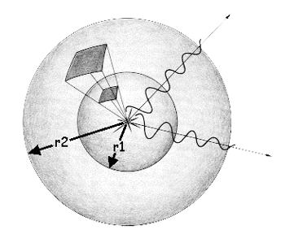
Spherical wave!
Intensity is isotropic. I = P/4πr². It falls off as 1/r²

Slide 56
如果波源为O（0，0，0），波面为
从原点发出的发散球面波
如果波面为
向原点汇聚的球面波

Slide 57
在一个平面（观察平面）上，球面波的位相分布不是恒定值。

Slide 58
轴上一点发散和汇聚的球面波

Slide 59
（0，0，z₀）发出的球面波在（x，y，0）平面的振动为
（0，0，-z₀）出发出的球面波在（x，y，0）平面上的振动亦为

Slide 60
向（0，0，z₀）点汇聚的球面波为
向（0，0，-z₀）点汇聚的球面波为

Slide 61
轴外一点发散和汇聚的球面波

Slide 62
如果点光源在轴外（x₀，y₀，±z₀），则发出和汇聚的球面波分别为

Slide 63
4．光波的复振幅描述
由于可以用复指数的实部或虚部表示余弦或正弦函数，所以可以用复数来描述光波的振动
指数取正号

Slide 64
定态光波的频率都是相等的，可以不写在表达式中。
定态部分，即与时间无关部分为
复振幅包含了振幅和位相，直接表示了定态光波在空间P点的振动，或者说复振幅表示了波在空间的分布情况。所以，凡是需要用振动描述的地方，都可以用复振幅代表。

Slide 65
光波场在P点的强度

Slide 66
四．有关光波的几个概念
1．波面：位相相等的空间点构成的曲面，也称波阵面。
2．波前：光波场中的任一曲面。
3. 波前函数：波前上的波函数
4．等幅面：振幅相等的空间点构成的曲面。
5．共轭波：波前函数（复振幅）互为共轭的波。
互为共轭的波，其传播方向应该是相关联的。

Slide 67
平面波的共轭波
由于上述角度是波矢于平面间的夹角，所以不能认为两列波的方向相反

Slide 68
在z=0平面上
如果θ2=0

Slide 69
球面波
从
发出
向
汇聚

Slide 70
5.波线
与波面垂直的直线，表示波的传播方向。
与波矢的方向是相同的。
在几何光学中，波线就是光线。

Slide 71
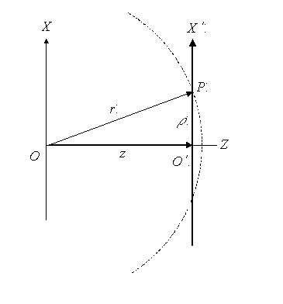
6．远场条件、近轴条件

Slide 72
（1） 轴上物点发出的球面波
接收屏与物平面相距较远

Slide 73
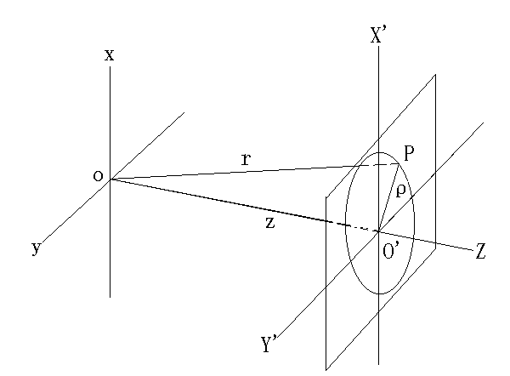

Slide 74
如果
近轴条件，傍轴条件
可以忽略
振幅为
在接收屏上，振幅为常数

Slide 75
如果
远场条件
可忽略
可作为平面波处理

Slide 76
远场条件
可以推得
近轴条件
远场条件包含近轴条件
近轴条件下，轴上物点发出的球面波为
远场条件下，轴上物点发出的球面波为

Slide 77
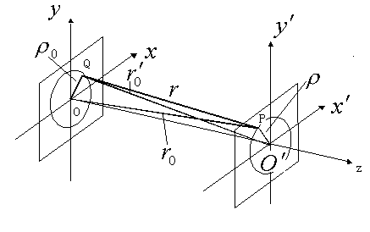
（2）轴外物点发出的球面波

Slide 79
Q到O的距离
物点场点都满足近轴条件时，有

Slide 81
屏上的复振幅为
振幅具有平面波的特点
远场条件为
物点
场点

Slide 82
如果物点Q再满足远场条件的话，有
或者，如果场点P再满足远场条件的话，有
振幅和相位都变为平面波
入射平面波的波矢为
沿着QO’方向

Slide 83
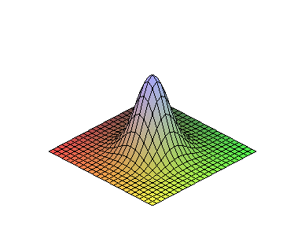
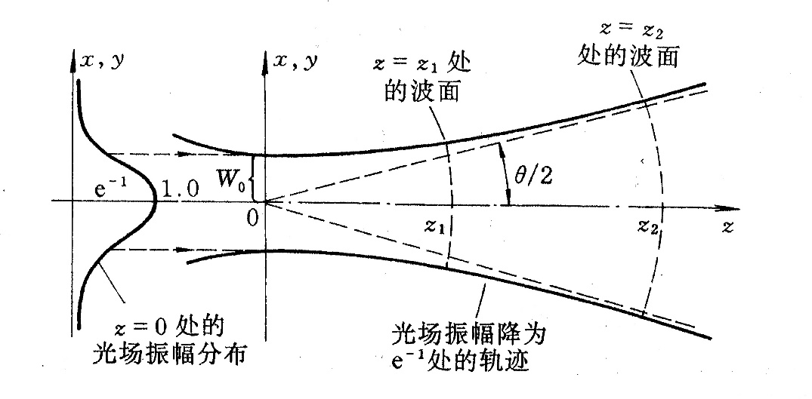
Gaussion waves
Basic mode (TEM₀₀):
Transformation by lens are totally different from the planar wave!!!
Notes:
最早，人们认为高斯解仅仅具有数学意义，但在激光出现后，人们意识到，高斯光是有实际物理意义的。这也是数学与物理结合的一个典型例子。

Slide 84
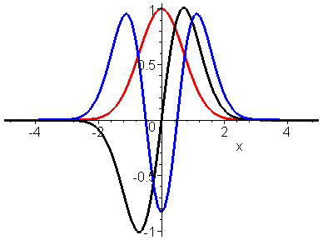
Higher order modes
Hermite-Gaussian beam
(1)

Slide 85
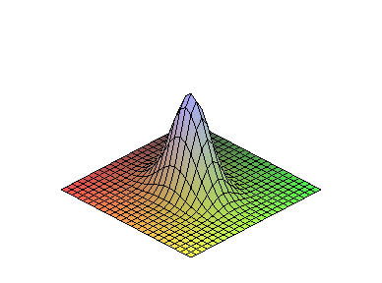
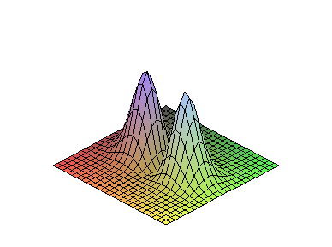
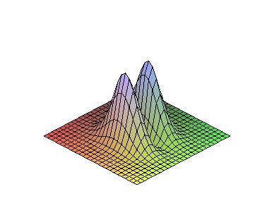
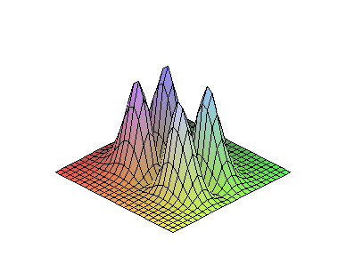
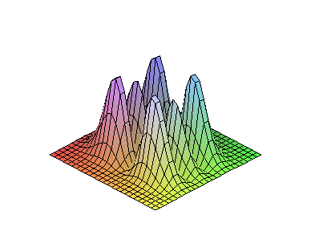
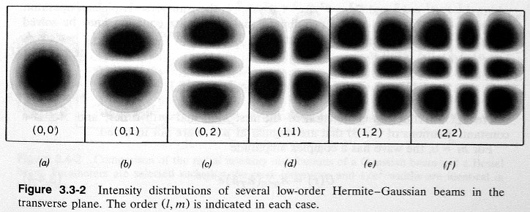
(0,0)
(1,0)
(1,1)
(0,1)
(2,1)

Slide 86
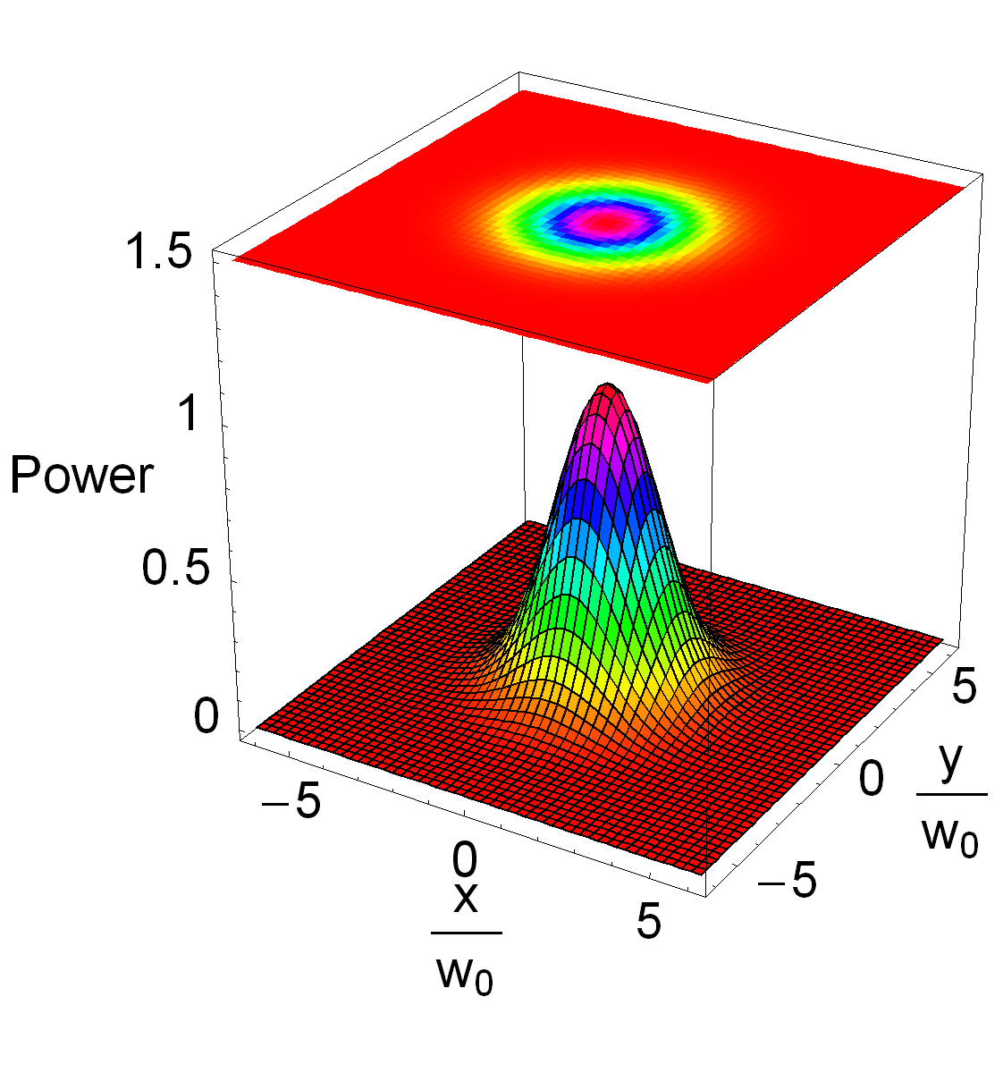
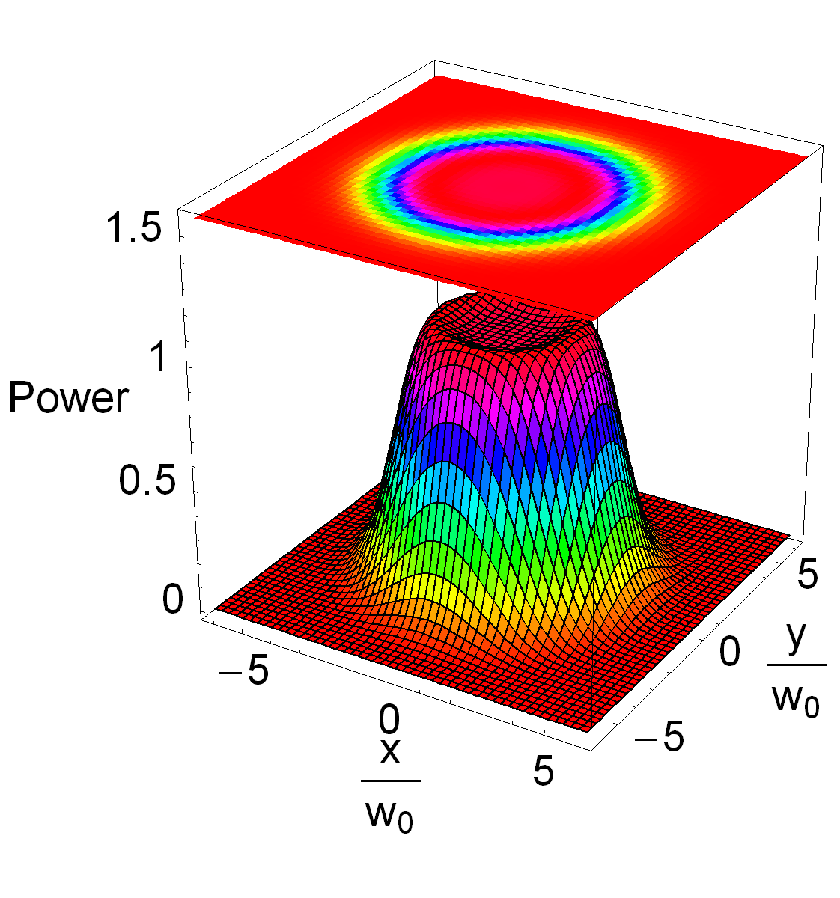
Flat-top beam
Gaussian beam
Flat-top beam
Simulation: Erika D’Ambrosio from Caltech

Slide 87
Bessel and Bessel-Gauss Beams
Bessel Beams
Diffraction-Free
Not physically realizable (infinite energy)
Conical phasefronts
Intensity independent of z (direction of propagation)
Bessel-Gauss beams
Finite energy derivative of Bessel Beams
Physically realizable
Intensity distribution and phasefronts shape depend on z
“Nearly” diffraction-free in a finite region
Nearly conical mirrors in some regime
Filed distribution everywhere
Bessel Beams
Bessel-Gauss Beams field distribution near z=0

Slide 88
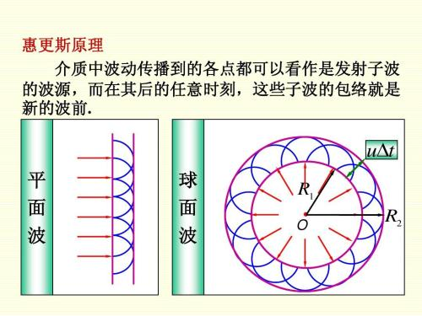
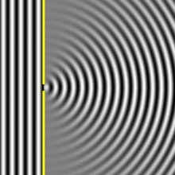
惠更斯原理

Slide 89
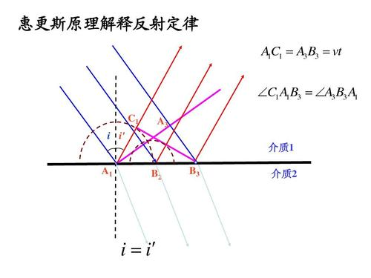

Slide 90
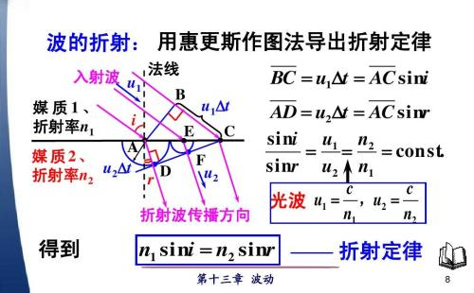
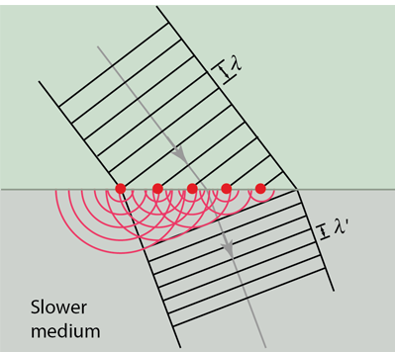
惠更斯原理

Slide 91
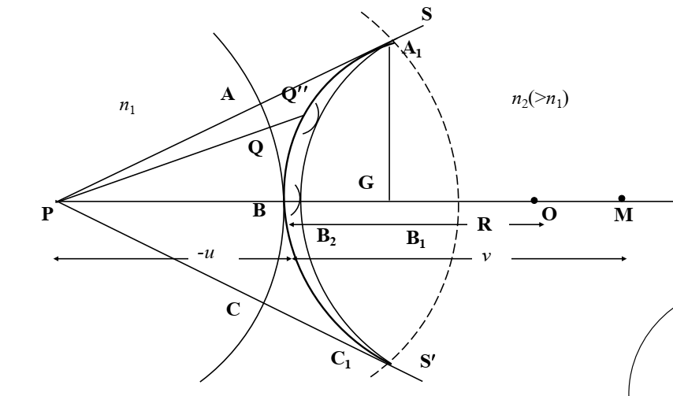

Slide 92
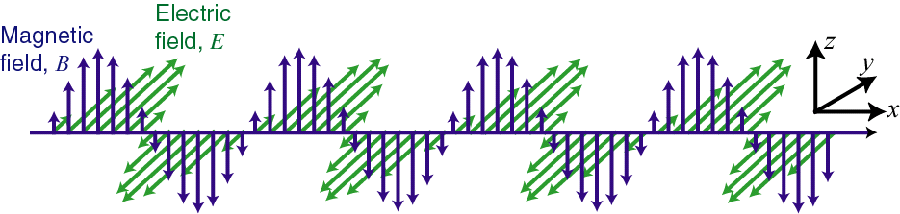
In the Lecture Previous
The electric field is along y-direction. k is along x direction
t=t₀

Slide 93
Polarization
Polarization, is an expression of the orientation of the lines of electric flux in an electromagnetic field (EM field). Polarization can be constant -- that is, existing in a particular orientation at all times, or it can rotate with each wave cycle.

Slide 94
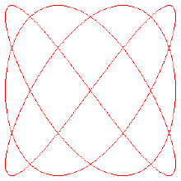
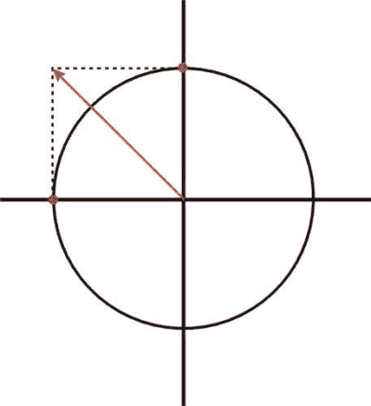
Polarization
All vibration can be resolved into three components according to the three orthogonal coordination axes. In light vector map, only need x- and y-components. In optical waveband, because of the high frequency of light, oscillations along x- and y- axis must have the same frequency.
In the following discussion, without special emphasis, consider of the polarization is limited at a certain spatial location.

Slide 95

Composition of Vibration / Lissajous Figure

Slide 96

45° Linear Polarization
E always points to particular direction.
E₀, the complex amplitude, is the same for x- and y-component.
E₀ may be complex or real. So we normally do not write here ϕ₀.

Slide 97
Linear Polarization with angular α
E-field vibrates over time and space but keeps its direction.
The y-component is in phase with the x-component, but has different magnitude.
α is the crossing angle viewing toward the light source
y
α
x

Slide 98
Jones Vector
A 2-dimensional vector containing
the two complex x- and y-amplitudes:
For many purposes, we only care about the relative values:
Arbitrary linear polarization:
0° linear (x) polarization: E_{y} /E_{x} = 0
90° linear (y) polarization: E_{y} /E_{x} = ∞
45° linear polarization: E_{y} /E_{x} = 1

Slide 99


Left Circular (or Helical) Polarization
x- and y- components are always 90°out of phase.
The E-field rotates counterclockwise around the k-vector (looking back at the source).
E-field variation over time and space
kz-ωt = 0°

Slide 100

Right Circular (or Helical) Polarization
E-field variation over time and space
x- and y- components are always 90°out of phase, but in the other direction.
The E-field rotates clockwise around the k-vector (looking back at the source).
y
x
kz-ωt = 0°
kz-ωt = 90°

Slide 101



Left and Right Handness

Slide 102

Left and Right Handedness
looking back at the source
Reflection changes the handedness (chirality)
Phase difference between x- and y- components decides the handness

Slide 103


Elliptical Polarization
y
x
E_{0x} and E_{0y} are complex amplitudes. The resulting E-field rotates clockwise or counter-clockwise around the k-vector (looking down the z-axis toward the origin).

Slide 104
JV for Circular and Elliptical Polarizations
Circular polarization has an imaginary Jones vector y-component
Right circular polarization
Left circular polarization
Elliptical polarization has both real and imaginary components:

Slide 105

Electric field of elliptical polarization
The locus of time sequence of electric field of an elliptical polarization in a plane perpendicular to the propagation follows an ellipse:

Slide 106
Electric field of elliptical polarization
A more convenient description is by transforming the previous equation to its principal axes form:
Then we have:
+ RHEP, -LHEP

Slide 107
Electric field of elliptical polarization
Ellipticity:
Ellipse's eccentricity:
Orientation angle: ϕ
Ellipticity angle:

Slide 108
Stokes vector of parameter

Slide 109
Stokes vector of parameter
These vector components give a complete geometric description of the vibrational ellipse:

Slide 110

Poincaré sphere or representation
It can be proved that :
For a completely polarized field only three of parameters or vector components are independent. And we can obtain the coordinates of the Poincaré sphere or representation as:

Slide 111
Natural Polarization
Lets consider the case:
where q_{x}(t) and q_{y}(t) are functions that vary temporally. If the variation time scale is slower than 1/ω, but too faster to be measurable, any single resultant polarization state is indiscernible. In this case, the light is of natural polarization, or randomly polarized.

Slide 112

Partial Polarization
More general case is that the electric field direction changes in a way that is neither totally regular nor totally irregular. It is called partial polarization. Normally we concern the partial polarization as the superposition of special amount of natural and polarized light.
A perfectly monochromatic plane wave is always polarized!!

Slide 113

How to measure polarization
We use Polaroid or Polarizer to measure the polarization. Ideally saying, only the linear polarization component along certain direction can pass the polaroid.

